Slide 1
Reference Reconciliation in Complex Information Spaces
Erinç Gökdeniz
2004721375

Slide 2
Reference Reconciliation
Introduction
Overview
Reconciliation Algorithm
  Dependency Graph
  Exploiting the Dependency Graph
  Enriching the References
  Enforcing constraints
Computing Similarity Scores
Experimantal Results
Related Work & Conclusions

Slide 3
Introduction
Reference Reconciliation is the problem of different references in a dataset corresponding to the same real-world entity
Because of mis-spellings,use of abbreviations, different naming conventions, naming variations over time.
Mainly a matter for data integration concept

Slide 4
Introduction
Most of the previous work considers,
  techniques for reconciling references to a single class.
  the data contains many attributes.
In practice,
  Complex Information spaces where instances of multiple classes
  Rich relationships between the instances
  Classes may have only few attributes
  References typically have unknown att. values

Slide 5
Proposed Reconciliation Algorithm
Main motivation is Personal Information Management
Supporting higher level browsing of information on one’s desktop.(PIM)
Examines data from sources on the desktop(e.g. Mails,files, spreadsheets)
Rec. Algo. addresses several shortcomings of existing reference reconciliation algorithms that preclude their use in applications such as PIM

Slide 6
Personal Information Management
Extract instances of multiple classes:
  Person, Message, Article, Conference
Extract associations :
  senderOf, authorOf, publishedIn..
Also, (aside from PIM)
  Publications
  Online product catalogs
  involves complex relationships between multiple entities

Slide 7
Proposed Reconciliation Algorithm
Exploit the associations between references to design new methods for reference comparison
Propogate information between reconciliation decisions to accumulate pos. and neg. evidences
Enrich references by merging attribute values.

Slide 8
Reconciliation Algorithm
The key ideas of the algorithm :
  Extensive use of context information to provide evidence for reconciliation decisions
    Example : for given 2 references algorithm also considers their co-authors and emails to decide whether to reconcile them

Slide 9
Reconciliation Algorithm
  Propagation of information between reconciliation decisions for different pairs of references
    Example : when we decide to reconcile two papers , we obtain additional evidence for reconciling the person references to their authors

Slide 10
Reconciliation Algorithm
  Addressing the lack of information in each reference by reference enrichment
    Example : when we reconcile two person references, we gather different representations of the person’s name , different mail addresses and can enlarge the co-author list.
    This enrichment can lead us to another reconciliations.

Slide 11
Problem Definition
A domain is modelled with a schema
Schema includes classes with attributes
Attributes :
  Atomic : Simple type like String, int
  Associations : whose values are links to other instances.

Slide 12

Schema

Slide 13
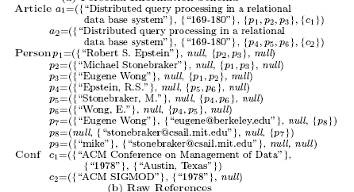
References

Slide 14
Reconciliation Results

Slide 15
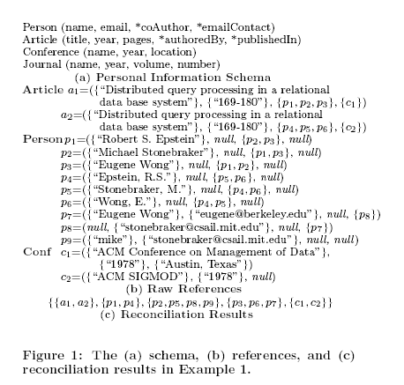

Slide 16
Measures of Quality
Recall
  Measures the percentage of correctly reconciled pairs of references over all pairs of references that refer to the same entity.
Precision
  Measures the percentage of correctly reconciled pairs over all reconciled pairs of references

Slide 17
Reconciliation Algorithm Details
First, costruct the dependency graph that captures the relationships between different reconciliation decisions
Iteratively re-compute scores that are assigned to reconciliation decision nodes in the graph until a fixed point is reached.
Finally, compute the transitive closure for the final reconciliation results

Slide 18
Dependency Graph
We need to compute the similarity for every pair of references of the same class,
Therefore, atomic and association attributes’ similarities
A node in the graph represents the similarity between a pair of references
An edge represents the dependency between a pair of similarities

Slide 19

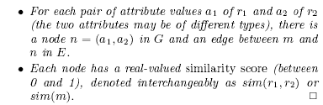
Definitions of Graph

Slide 20
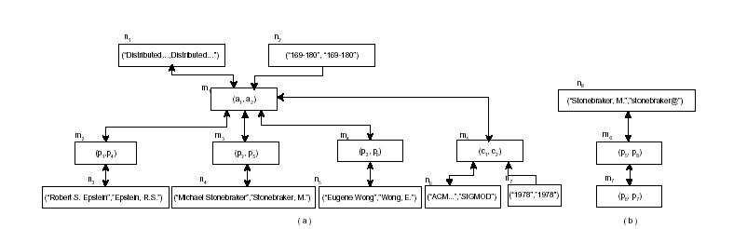
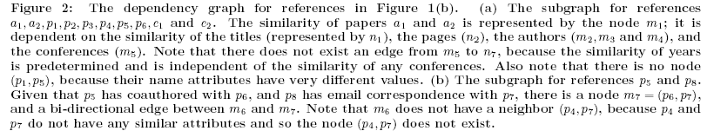

Slide 22
Some Definitions
We call n an incoming neighbor of m,
and m an outgoing neighbor of n .
If the similarity of a node n depends only whether the references in the node m are reconciled, then we say m is a boolean-valued neighbor of n
If the similarity of n depends on the actual similarity value of node m, we call m is a real-valued neighbor of n

Slide 23
Some Definitions
If the reconciliation of m’s two references implies that the two references in n should also be reconciled, m is called n’s strong-boolean-valued neighbor.
If the reconciliation of m’s references only increases the similarity score of n, but does not directly imply reconciliation, m is called n’s weak-boolean-valued neighbor.
  e.g..The similarity score of 2 persons will increase given that they have email correspondence with the same person

Slide 24
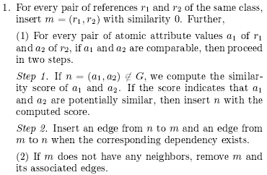
Graph Construction
Step 1

Slide 25

Graph Construction
Step 2

Slide 26
Exploiting the Dependency Graph
Algorithm is based on propogating similarity decisions from node to node.
e.g.. After deciding to reconcile articles a1 and a2 we should reconcile their associated conferences c1 and c2,
Further, re-computation of the similarities of other papers that mention the conferences c1 and c2 is required

Slide 27
Nodes
Merged : when a node’s similarity score is above a merge-threshold (it represents reconciled references)
Active : if a node’s similarity is reconsidered
Inactive : the rest..
Initially all nodes representing the similarity between references are marked active
The nodes representing the similarity between atomic attribute values are marked merged or inactive depending on their associated similarity score

Slide 28
Nodes
At a time one active node is selected and its similarity score is recomputed
If the new similarity score is above merge-threshold ,node is marked as merged
Otherwise it is marked as inactive
In addition, all its neighbours with similarity scores below 1 is marked as active.

Slide 29
Exploiting the Dependency Graph
This algorithm maintains a queue of active nodes containing all reference-similarity nodes
At every iteration, we compute the similarity score for the top node

Slide 30
Enriching the References
After merging references r1 and r2, all the attributes of r2 can be considered as those of r1.
When there is another reference r3, we choose the one with higher similarity.
Example : connecting all neighbours of n we can remove node n.
  if m gets new incoming neighbours and is not active, then m is inserted at the end of the queue

Slide 31
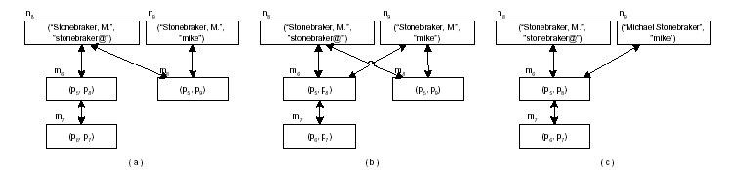
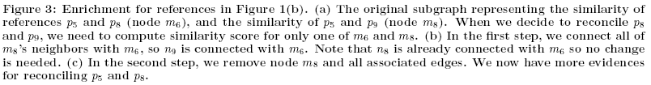

Slide 32
Enforcing Constraints
In many cases, negative evidences can contribute to the reconciliation process. (e.g. p2 & p9)
Constraint : is a rule enforcing that two references are quarenteed to be distinct.
  e.g..the authors of one paper are distinct
  Typically domain-dependent
  Non-merge node : The two elements are quarenteed to be different and should never be reconciled

Slide 33
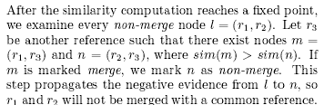
Definitions
(for constraints)

Slide 34
Computing
Similarity Scores
Given a node m=(r1,r2), the similarity function for m takes the similarity scores of m’s neighbors as input and computes a score between 0 and 1
The similarity score is sum of 3 components
  Srv→contributed by real-valued incoming neigh.
  Ssb→contributed by strong-boolean-valued neigh.
  Swb→contributed by weak-boolean-valued neigh.

Slide 35
Real-Valued Neighbors

Slide 36
Strong-boolean Neighbors

Slide 37
Weak-boolean Neighbors

Slide 38
Experimantal Results
Tests on two domains :
  Personal Information Management
  Publication Portal
Different 4 personal datasets is used
Conference and Journals are merged(Venue class)
Performance is measured by recall, precision and F-measure
F-measure = 2*prec*recall / prec+recall

Slide 39
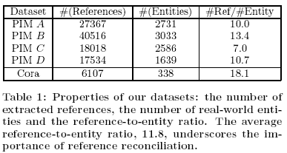
Datasets

Slide 40
Experiments
Proposed Algorithm is DEPGRAPH
General Reconciliation Approach : INDEPDEC
INDEPDEC compares person names and emails independently and combines the results for reference similarity without exploiting the dependencies between individual reconciliation decisions.

Slide 41
Experiments
DEPGRAPH ,in addition, compares the names with the email accounts,considers the articles authored by the persons, counts the common people appearing in the coauthor or email-contact lists,applies reconciliation propogation and reference enrichment and enforces constraints.

Slide 42
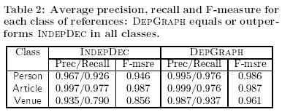
Results

Slide 43
Experiment Results
DEPGRAPH obtains higher precision and recall for both person and venue references.
It improved recall for venue ref. by %18.6
for person ref. by %5.4
=======
Secondly, examine person references
Dividing dataset into two
One contains person ref.extracted only from emails(PEmail)
One contains person ref. extracted from articles
(PArticle)

Slide 44

Results
DEPGRAPH improves recall
by %30.7 on the article datasets
by %7.6 on the email datasets
by %5.4 on the full datasets

Slide 45
Conclusions & Future Work
Many applications are based on information spaces that involve multiple classes and rich relationships between instances
Thus far studies are in the context of reconciling ref. of a single class.
This paper fills in this gap by proposing a generic framework

Slide 46
Conclusions & Future Work
This framework influences later similarity computation with early reconciliation decisions, and enriches references by instant merging.
Proposed algorithm obtains high precision and recall on test datasets.
In the future,
  An efficient incremental reconciliation approach
  Learning techniques based on the framework could be considered.

Slide 47
Questions
???

